Slide 1

Monte Carlo Simulation in Stardew Valley Mining game

Slide 2
Content
1. Game Background
2. The Mines
3. Prerequisites for using Monte Carlo
4. Basic Assumptions
5. Validating
6. Hypothesis
7. Conclusion

Slide 3
1. Game Background
Stardew Valley is an open-ended country-life Role-playing Game. You’ve inherited your grandfather’s old farm plot in Stardew Valley. Armed with hand-me-down tools and a few coins, you set out to begin your new life. Can you learn to live off the land and turn these overgrown fields into a thriving home?
Stardew Valley Wiki: https://stardewvalleywiki.com/Stardew_Valley_Wiki

Slide 4
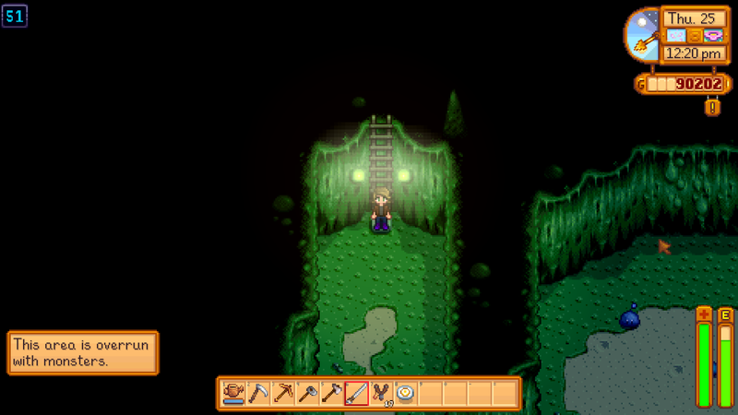
2. The Mines
We don’t want to overwhelm ourselves by the complicated playing mechanisms in this game, so we decide to choose one of them to investigate. We think the mining part of this game is a good place to start.

Slide 5
Introduction:
There are 120 floors (sometimes called levels) in the Mines. Ore type and quantity increases as The Player moves deeper into the Mines. The Mines are filled with rocks and dirt patches. Rocks can be mined with a Pickaxe in order to obtain Stone, ore and Geodes. A Hoe can be used on dirt patches to collect Minerals, Artifacts, ore, Clay, and Cave Carrots. To advance deeper in the Mines, a ladder must be revealed on each floor. The ladder will appear after breaking rocks or after defeating an enemy (killing enemies is the stamina-free option to finding ladders). If a floor is "infested" or "overrun" by monsters, all enemies must be defeated on that floor before a ladder will appear.

Slide 6
Elements:
Floor
Rocks
Equipment
Skill level
Monster
Attack
Health bar and Energy bar

Slide 7
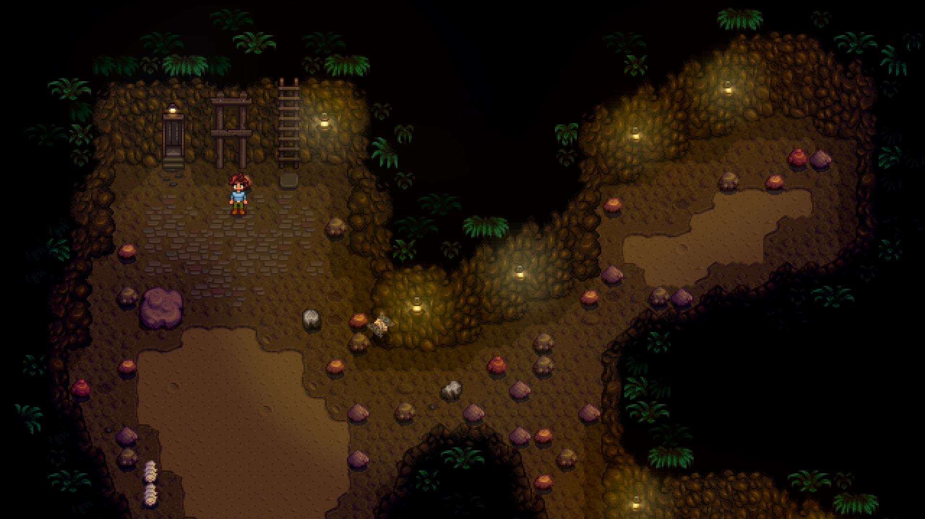
Floor
There are 120 floors in total, the map is drawn randomly with different types, and there are random rocks scattered in the floor.
To get to the next floor, you need to find the ladder which is hid under a random rock.
There is an elevator to get you to 10, 20, 30…, those floors have treasure chest with different items

Slide 8
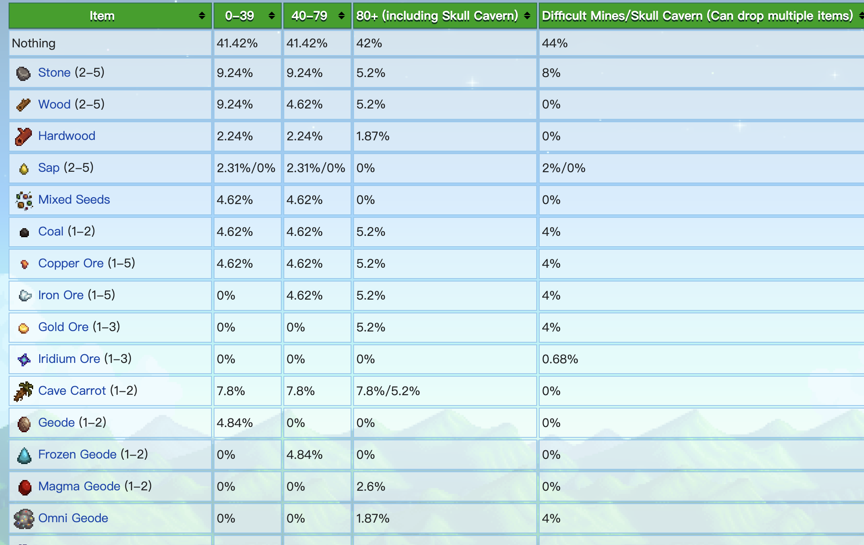
Rocks
Rocks are randomly scattered in the floor. You need a pickaxe to crack the rock. Stone, ore and Geodes will be gained with a set probability. The probability is listed on the Stardew Valley Wiki. The geodes require extra step to be cracked again (money cost) to gain actual items.
There is one rock under which is the ladder
Notes:
LL

Slide 9
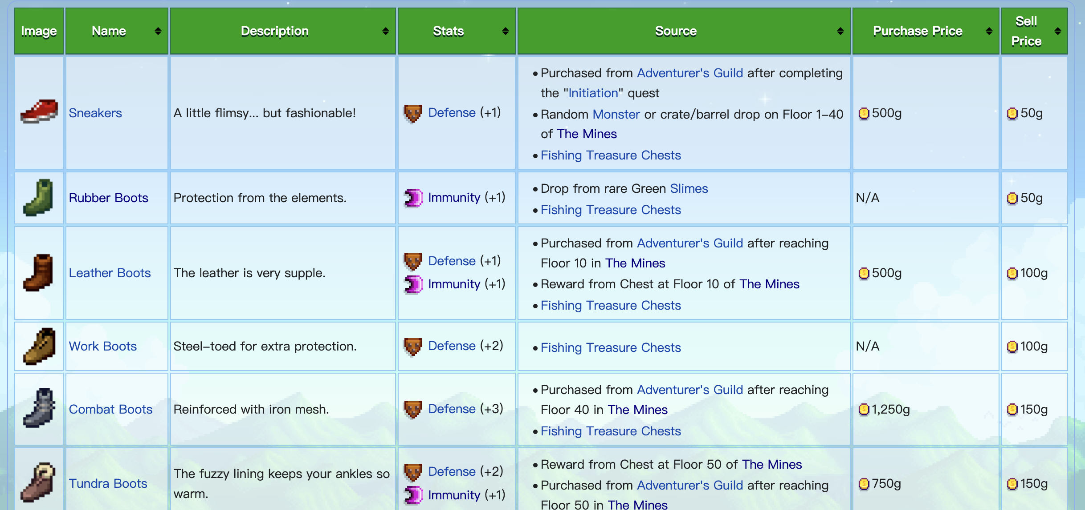
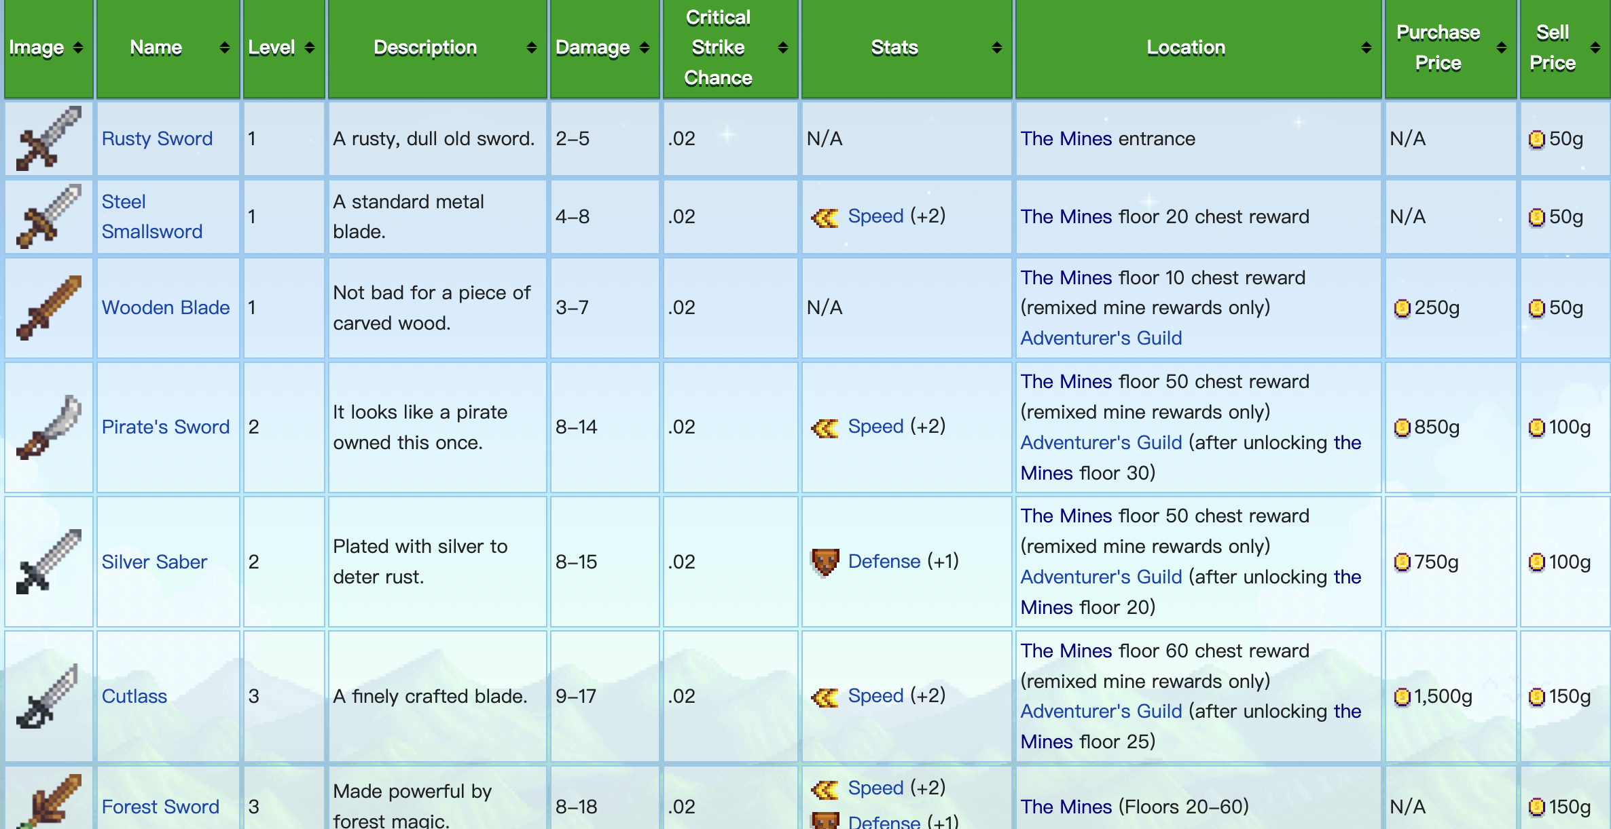
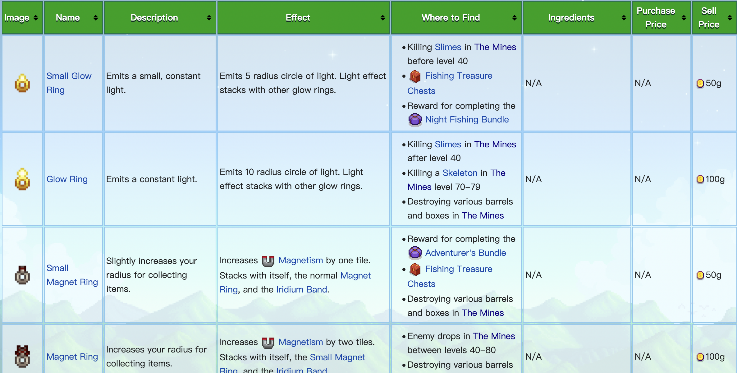
Equipment
The player can equip a weapon, a pair of footwear and two rings, which affects the attacking attributes.

Slide 10
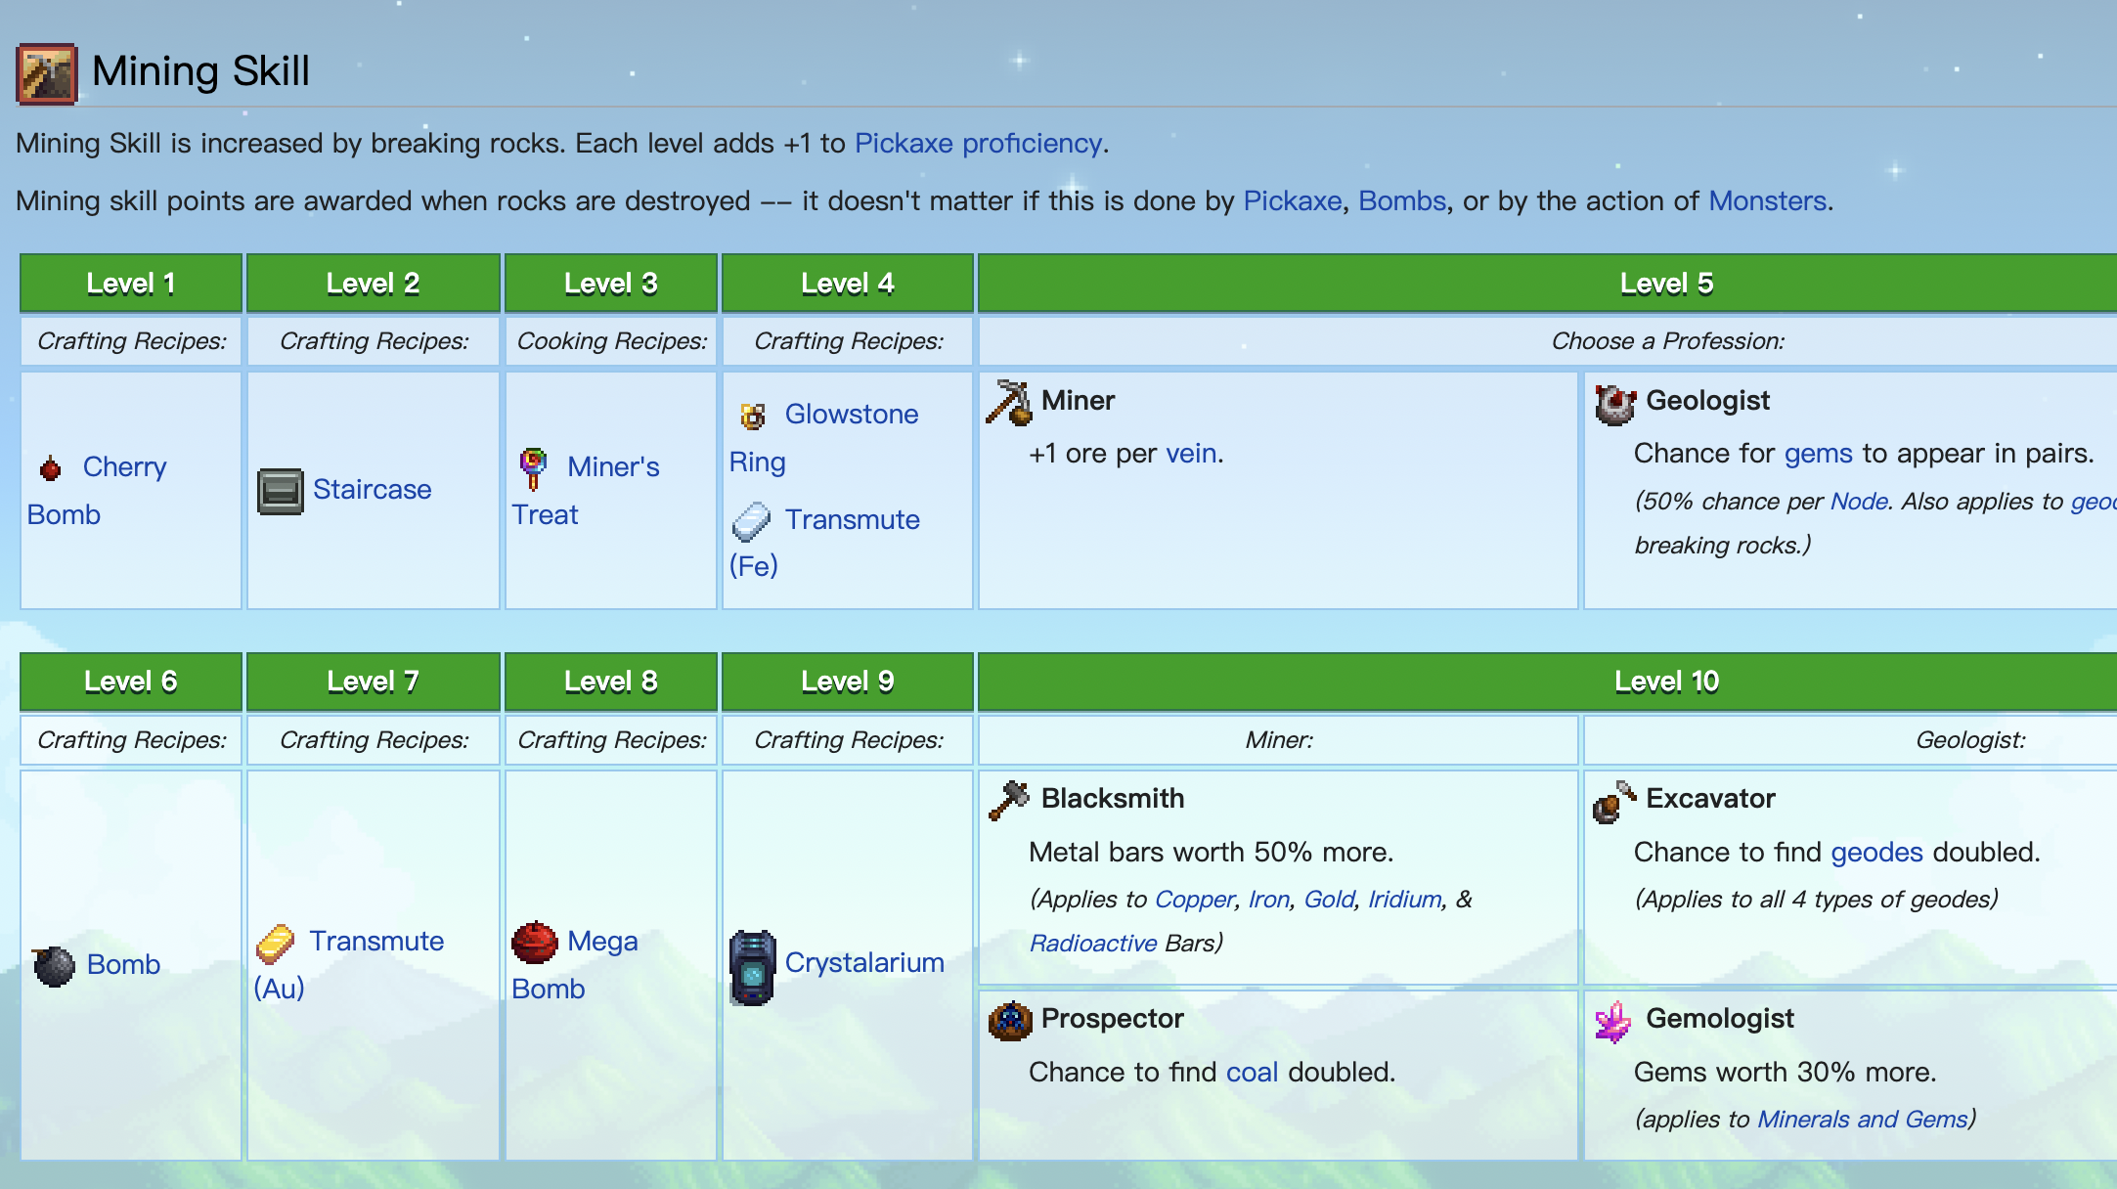
Skill level
There are five different skills in the game, but only the mining skills is considered in out simulation.
There are 10 levels in total, when achieving level 5, you can choose different occupation, and each will lead to different rewards in the next 5 levels.

Slide 11
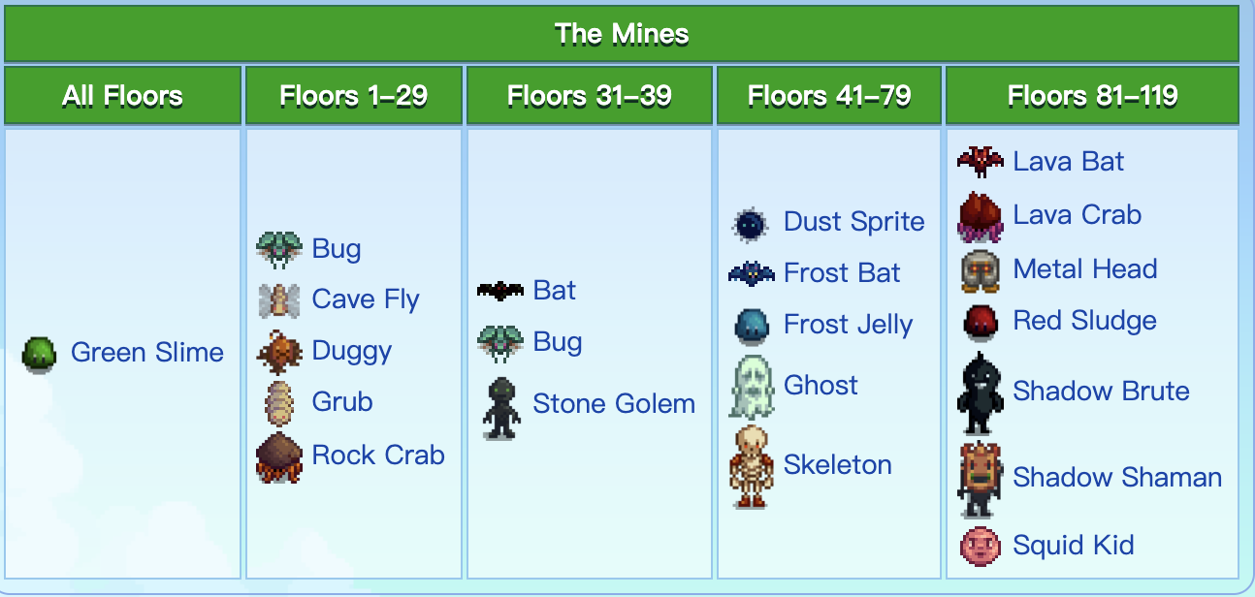
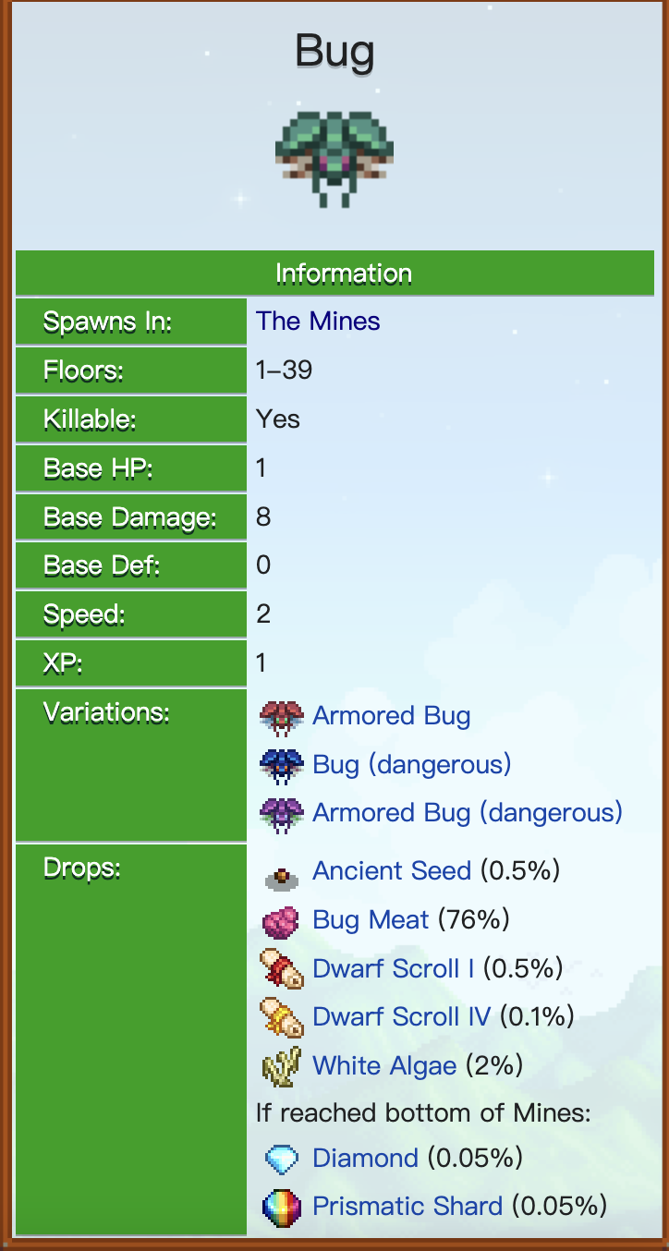
Monster
There will be monsters in each floor. The types of monsters vary through the depth of the floor, and different monsters have unique traits. After killing a monster, items will be dropped.

Slide 12
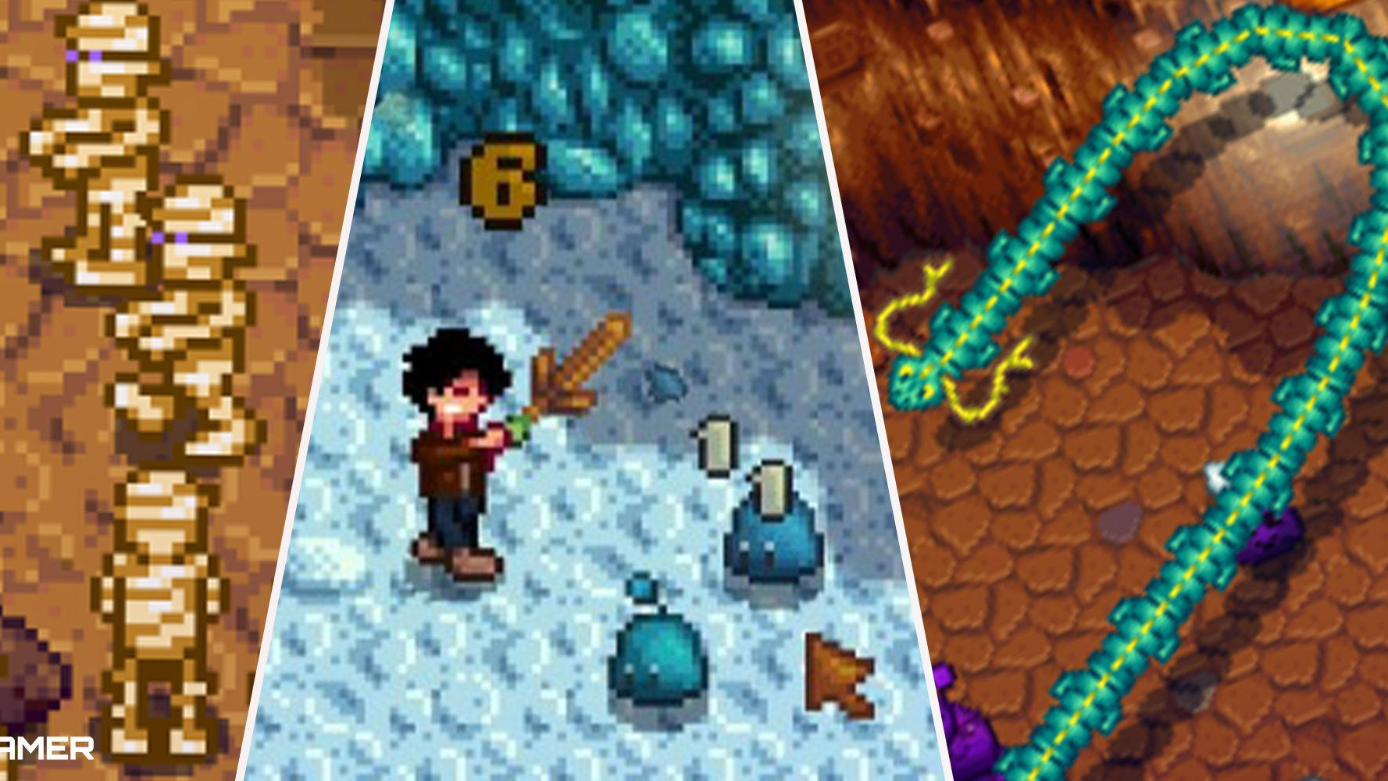
Attack
Attack happens between the player and the monsters.
The attributes include: Attack, Crit. Chance, Crit. Power , Defense , Immunity, Luck, Magnetism, Speed, Weight

Slide 13

Health bar and Energy bar
The attack from the monsters affects the health bar, the using of pickaxe and player attacking affects the energy bar

Slide 14
3. Prerequisites for using Monte Carlo
Rerun and Independence:
We consider the exhaustion of either health bar or energy bar as the end of one day. So tomorrow is another day!!!
summary of aggregate statistics:
we compare the total values of gained items in this one-day mining. Since it generates a whole bunch of data, we will draw it using pandas to see the trends (if convergent, we guess it might be a normal distribute). Simply using the mean value and the variance could also be the metrics.
Experiments and predictions
We will use it to verify our hypothesis
Notes:
YZ

Slide 15
4. Basic Assumptions
There is no supplement to fulfill the health bar and energy bar. The exhaustion of either bar means the day ends.
When fighting with the monsters, the player and the monster take turns to attack each other.
The value of items are determined by the directly selling value, and the player won’t process them into more valuable products.
The player will only enter the next floor after all the monsters are killed and all the items are collected.
If the game ends, the items the player gained in that level will be proportional to the monsters the player killed.
The attack damage will conform uniform distribution between min damage and max damage.
The numbers of rocks in every floor will conform uniform distribution between [30, 50], and monsters between [5,10]
Notes:
PW

Slide 16
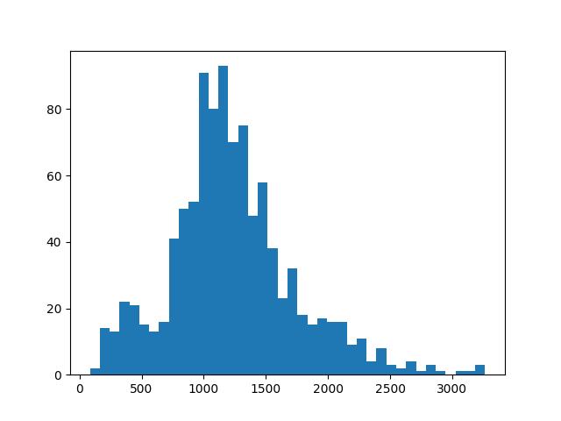
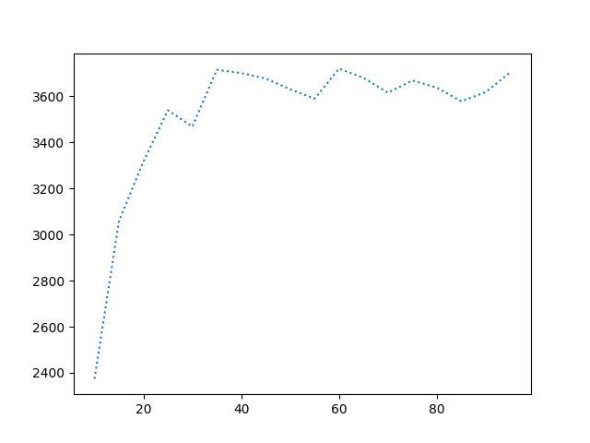
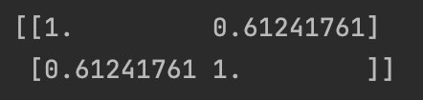
5. Validating
Statistical convergence
logical correlation （player attack damage and total value gained）
coefficient

Slide 17
6. Hypothesis
With the simulation ready, we can verify a lot of hypothesis, such as:
1. When equipped with the infinity dagger, it is more rewarding to start from 80th floor than from 1st floor.
2.•The ruby ring is more useful than the jade ring when equipped with Burglar's Shank and starts from 1st floor.
3. When reaching level 5 of mining skills, it is more rewarding to choose miner than geologist.

Slide 18
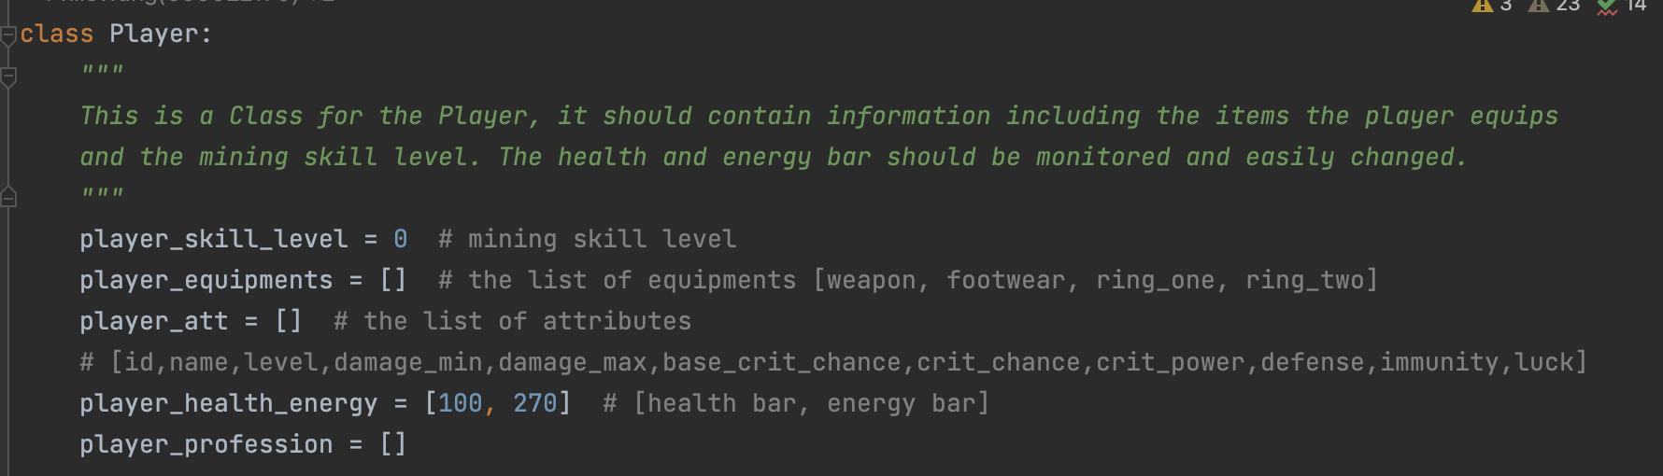
6. 1 Hypothesis 1
When equipped with the infinity dagger, it is more rewarding to start from 80th floor than from 1st floor.
Notes:
WANG

Slide 19
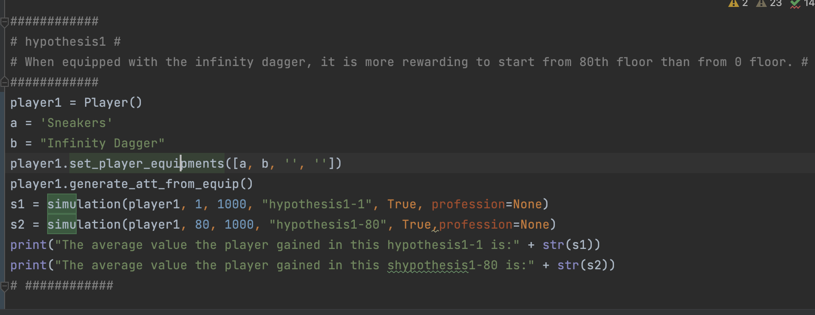
6. 1 Hypothesis 1

Slide 20
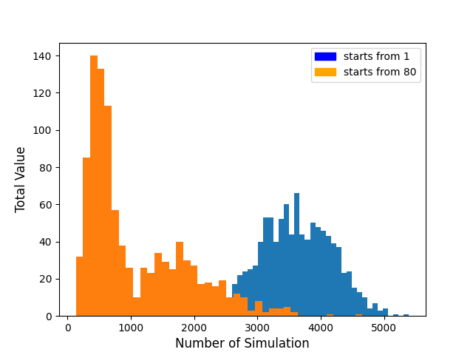
6. 1 Hypothesis 1
When equipped with the infinity dagger, it is more rewarding to start from 80th floor than from 1st floor.
The player can choose to start from 1st, 10th, 20th…floor. When the floor is deeper, the rocks will generate more valuable items,
but the monsters will also advance.
We simulate the program 1000 times. From the program output, the resulting average total value of starting from 1st floor is 3618
the average total value of starting from 80th is 1068
From the histogram, we can see that it is more rewarding to start from 1st floor than from 80th floor.
Thus, this hypothesis is not valid.

Slide 21
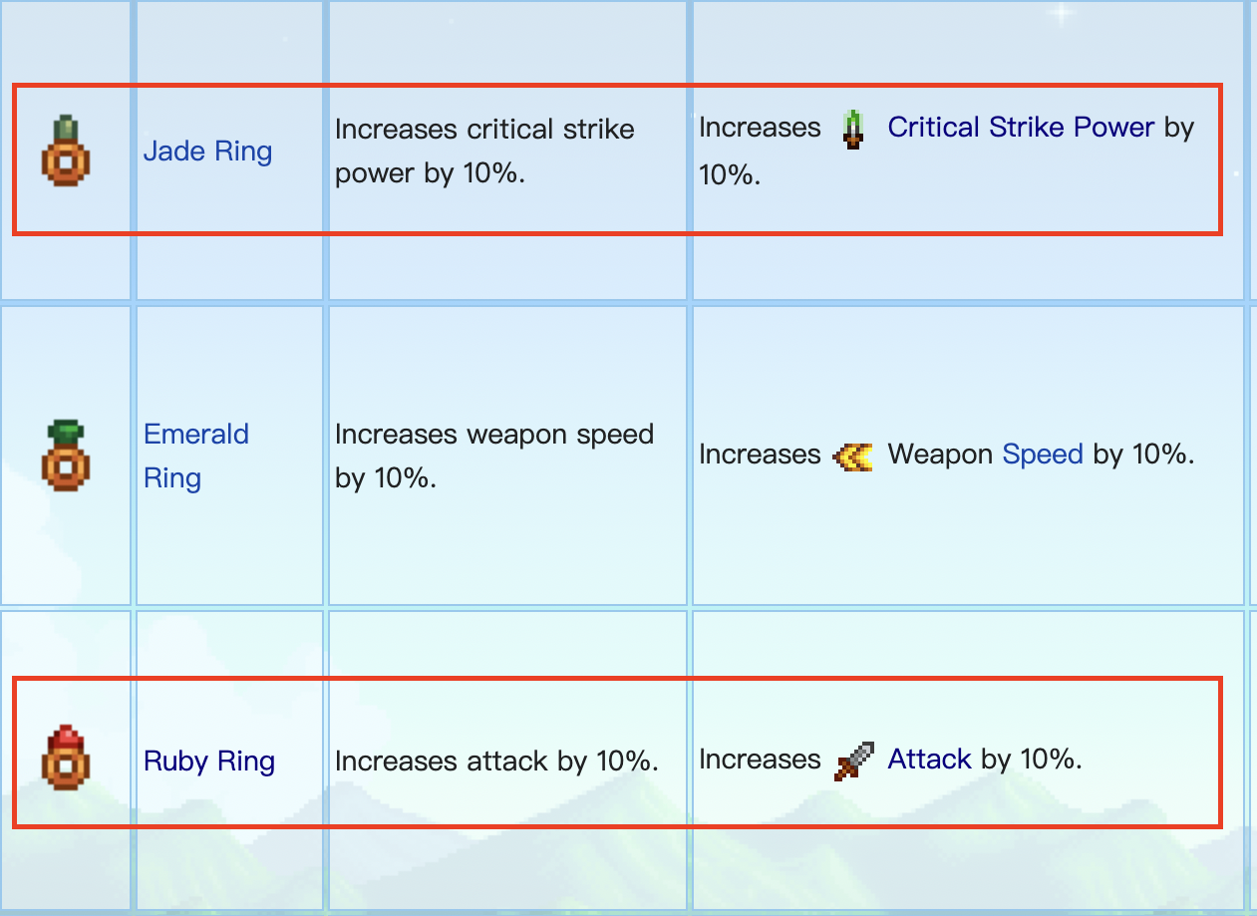
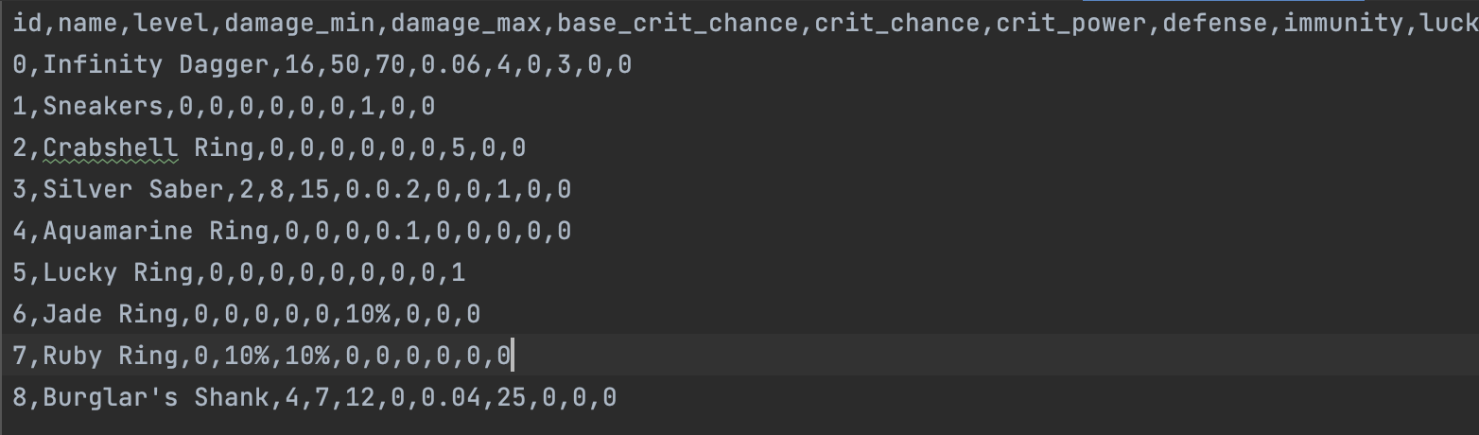
6.2 Hypothesis 2
The ruby ring is more useful than the jade ring when equipped with Burglar's Shank.

Slide 22
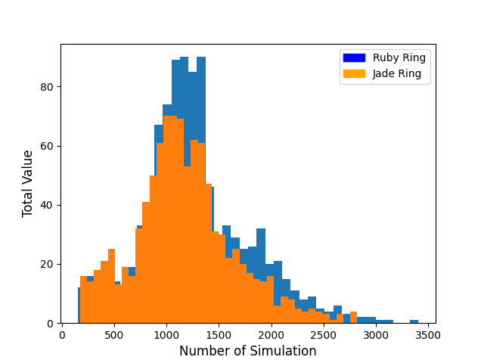
6.2 Hypothesis 2
We simulate the program 1000 times. From the program output, the resulting average total value of Ruby Ring is 1275
the average total value of Jade Ring is 1172

Slide 23
6.2 Hypothesis 2
The ruby ring is more useful than the jade ring when equipped with Burglar's Shank.
The hypothesis is valid

Slide 24
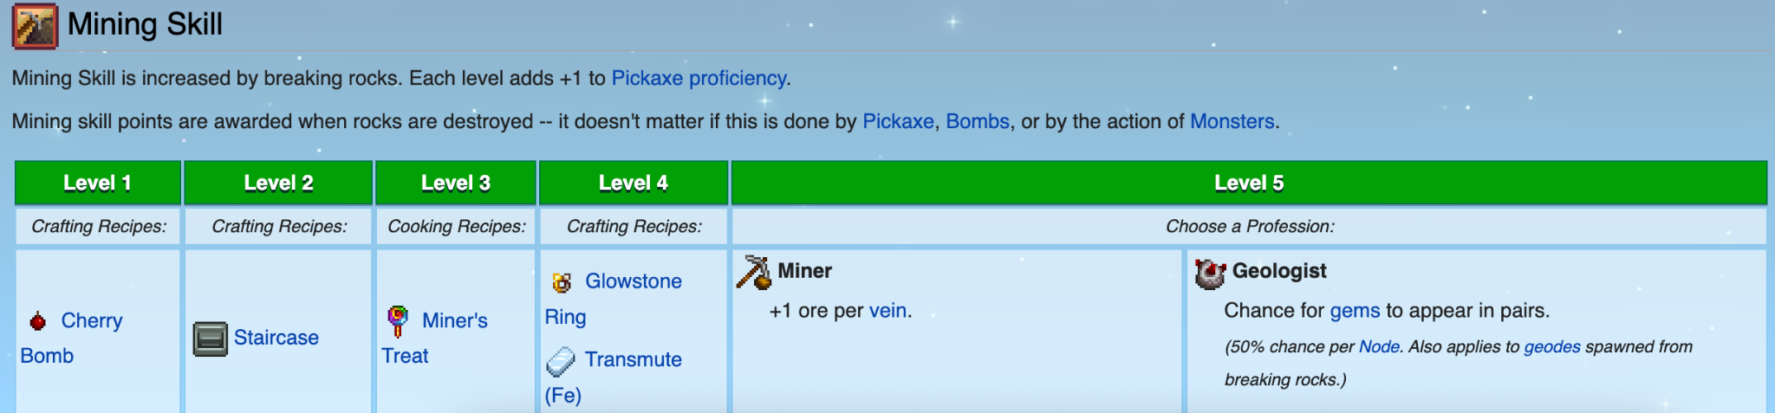
6.3 Hypothesis 3
When reaching level 5 of mining skills, it is more rewarding to choose miner than geologist.

Slide 25
6.3 Hypothesis 3
When reaching level 5 of mining skills, it is more rewarding to choose miner than geologist.
Method: fixed Parameter: Skill level 5, Player equipped with Sneakers and Infinity Dagger
Variables: simulation 500 times of two professions, Miner and geologist. We compare the resulting total gold value of two different professions. Finally we choose either the miner or geologist to be the more rewarding profession.
Notes:
LL

Slide 26
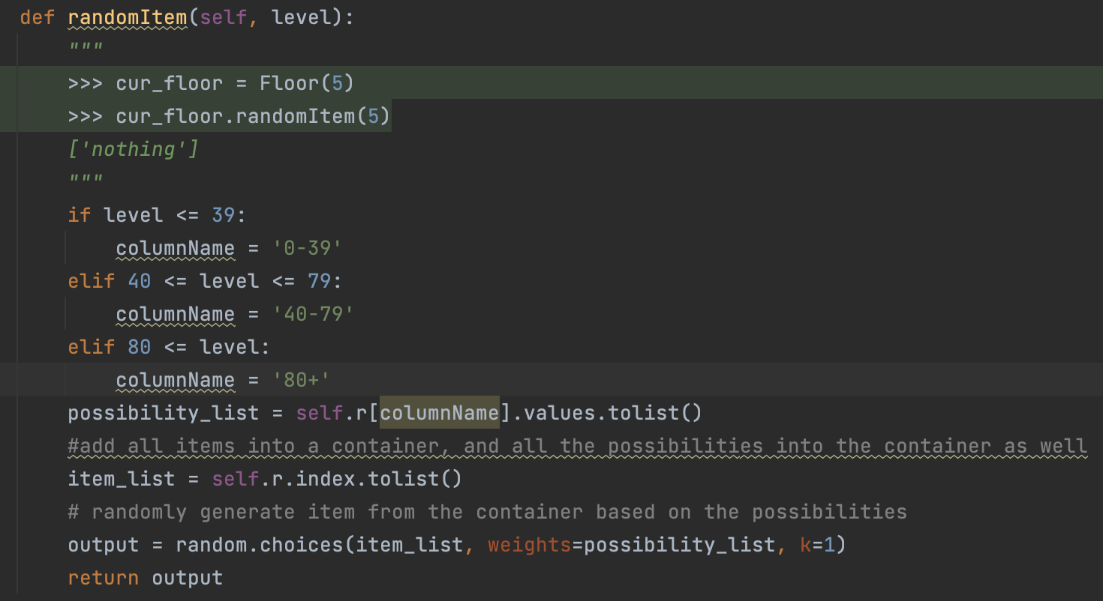
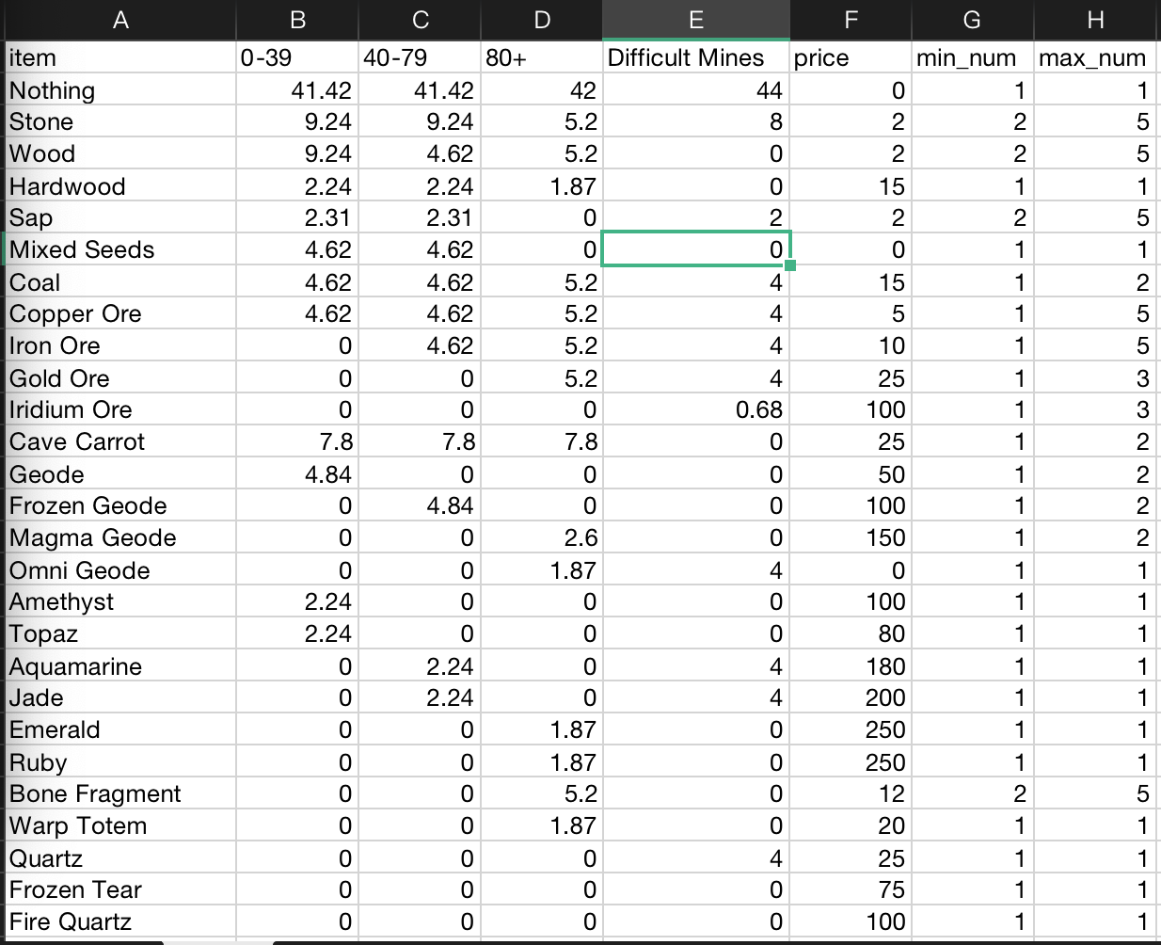
6.3 Hypothesis 3
Background of rock funcion
Notes:
LL

Slide 27
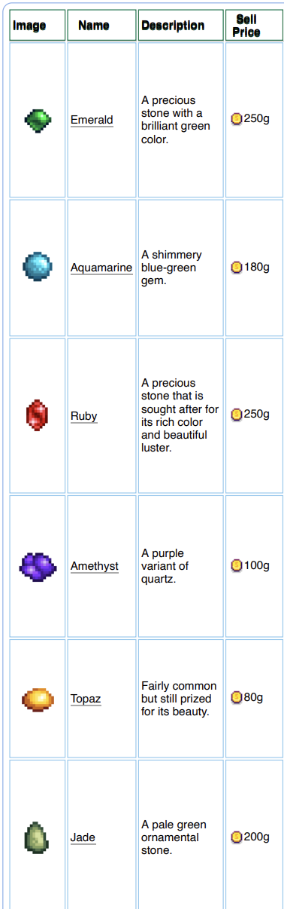
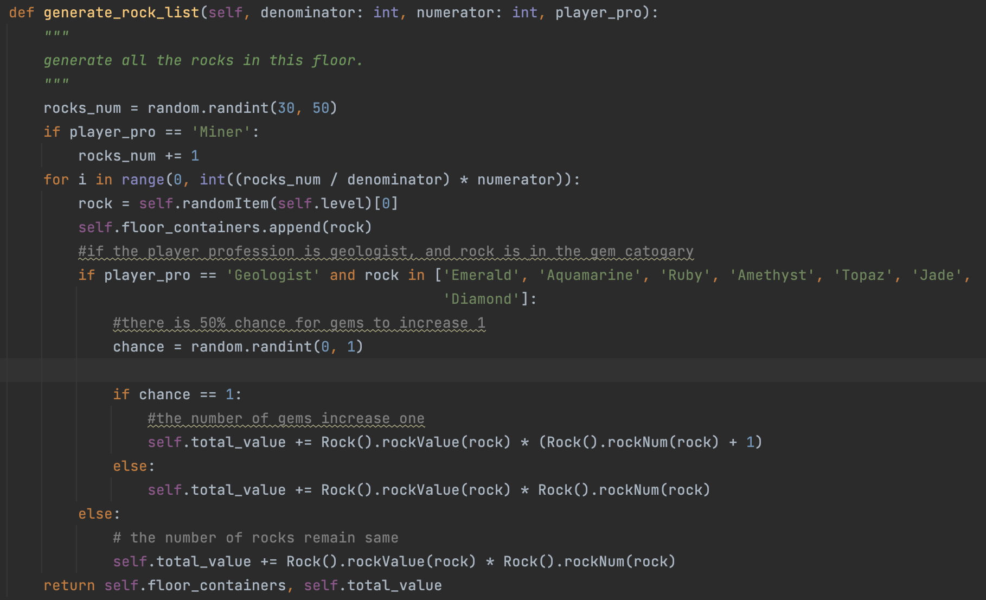
6.3 Hypothesis 3
Effect of Geologist: we crack the rocks and if the gems drop from the rock, then there is 50% chance the gem number will increase one.
Effect of Miner: On each floor, the number of rocks is increased by one.
Notes:
LL

Slide 28
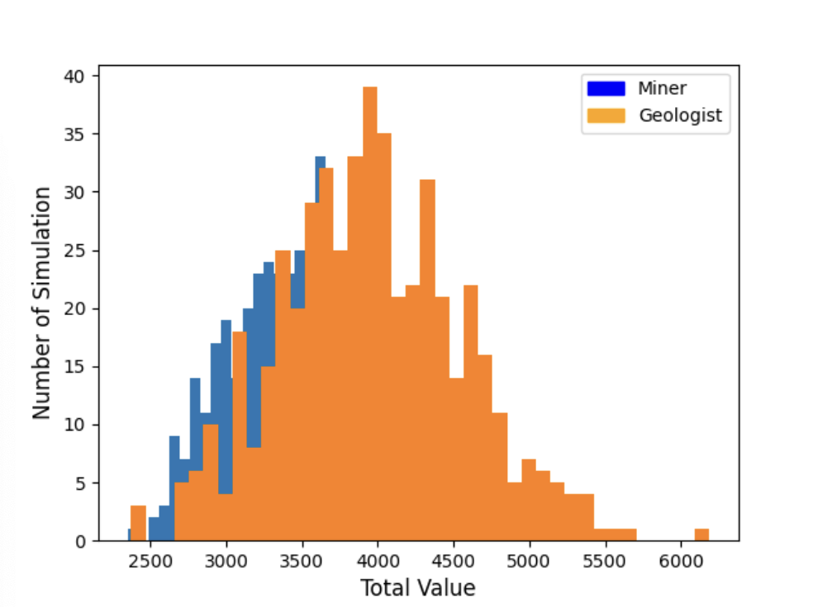
6.3 Hypothesis 3
We simulate the program 500 times. From the program output, the resulting average total value of Miner is 3593
the average total value of Geologist is 4262
From the histogram, we can see that the Geologist profession can produce more values than the Miner
Notes:
LL

Slide 29
7. Conclusion
1. When equipped with the infinity dagger, it is not more rewarding to start from 80th floor than from 1st floor.
2.The ruby ring is more useful than the jade ring when equipped with Burglar's Shank and starts from 1st floor
3. When reaching level 5 of mining skills, it is more rewarding to choose miner as profession than geologist.
Notes:
LL

